Slide 1

🛒 Online Shopping Checkout
A computational thinking exploration of the final process in buying something online
MADE BY :
Abhinandan Mishra
Btech Cybersecurity

Slide 2




Understanding the Process
What is Online Shopping Checkout?
Review Your Cart
Add Your Address
Check the items you've selected and their quantities
Enter delivery information for shipping
Choose Payment Method
Confirm Your Order
Select how you want to pay for your order
Finalize and submit your purchase
This process is done millions of times daily on platforms like Amazon, Flipkart, and Myntra.

Slide 3









The Full Customer Journey
From Discovery to Delivery: The Complete Online Shopping Process
Understanding every step from when a customer first finds a product until it arrives at their door.
Browse & Search
Customers explore products through categories, recommendations, or direct search.
Add to Cart
Selected items are added to a virtual shopping cart, ready for purchase.
Review Cart
Customers verify chosen items, quantities, and prices before proceeding.
Enter Shipping
Delivery address and preferred shipping options are provided.
Select Payment
Customers choose their preferred payment method, such as credit card or digital wallet.
Confirm Order
All order details are finalized, and the purchase is officially placed.
Process Payment
The financial transaction is processed and verified by the payment gateway.
Order Confirmed
An email or in-app notification confirms the successful purchase.
Track Delivery
Customers receive updates and can monitor their package's journey until arrival.

Slide 4
💡 Why I Chose This Scenario
Personal Experience
Real-Life Relatability
Clear Structure
I have experience online shopping, so I understand how the process works from the user side.
This is a real-life scenario that is relatable and has logical order steps for breakdown.
It has a straightforward configuration: Input → Processing → Output. This makes it ideal for demonstrating computational thinking.

Slide 5

🧠 How It Connects to Computer Science
Algorithms and backend systems drive the checkout process.
It includes decision making (failure or success of payment), data manipulation (cart items and address), and user interaction.
I can understand how real-world systems are built using code and logic by simulating this process.

Slide 6

Why This Matters
Real-World Relevance
In today's digital world, online shopping is a popular activity.
Knowing how checkout works gives us insight into the impact of computer science in our day to day activities.

Slide 7



🎯 Learning Goals
Abstraction
Decomposition
Pattern Recognition
Understanding how to apply abstraction by looking only at the checkout section, rather than the whole site.
Learning how to strategically use decomposition by segmenting the checkout process into smaller parts, such as the cart review, address entry, and payment.
Identifying patterns recognition describing repeated, common elements in different systems.

Slide 8
🧪 Expected Deliverables for the Assignment
1
Flowchart
2
Pseudocode
A flowchart detailing every step involved in the checkout process.
Pseudocode that explains the logic step in layman terms.
3
Python Program
4
Self-Reflection
A basic Python program that demonstrates part of the checkout process.
A self-reflection on the understandings gained from the exercise and the areas for enhancement.

Slide 9
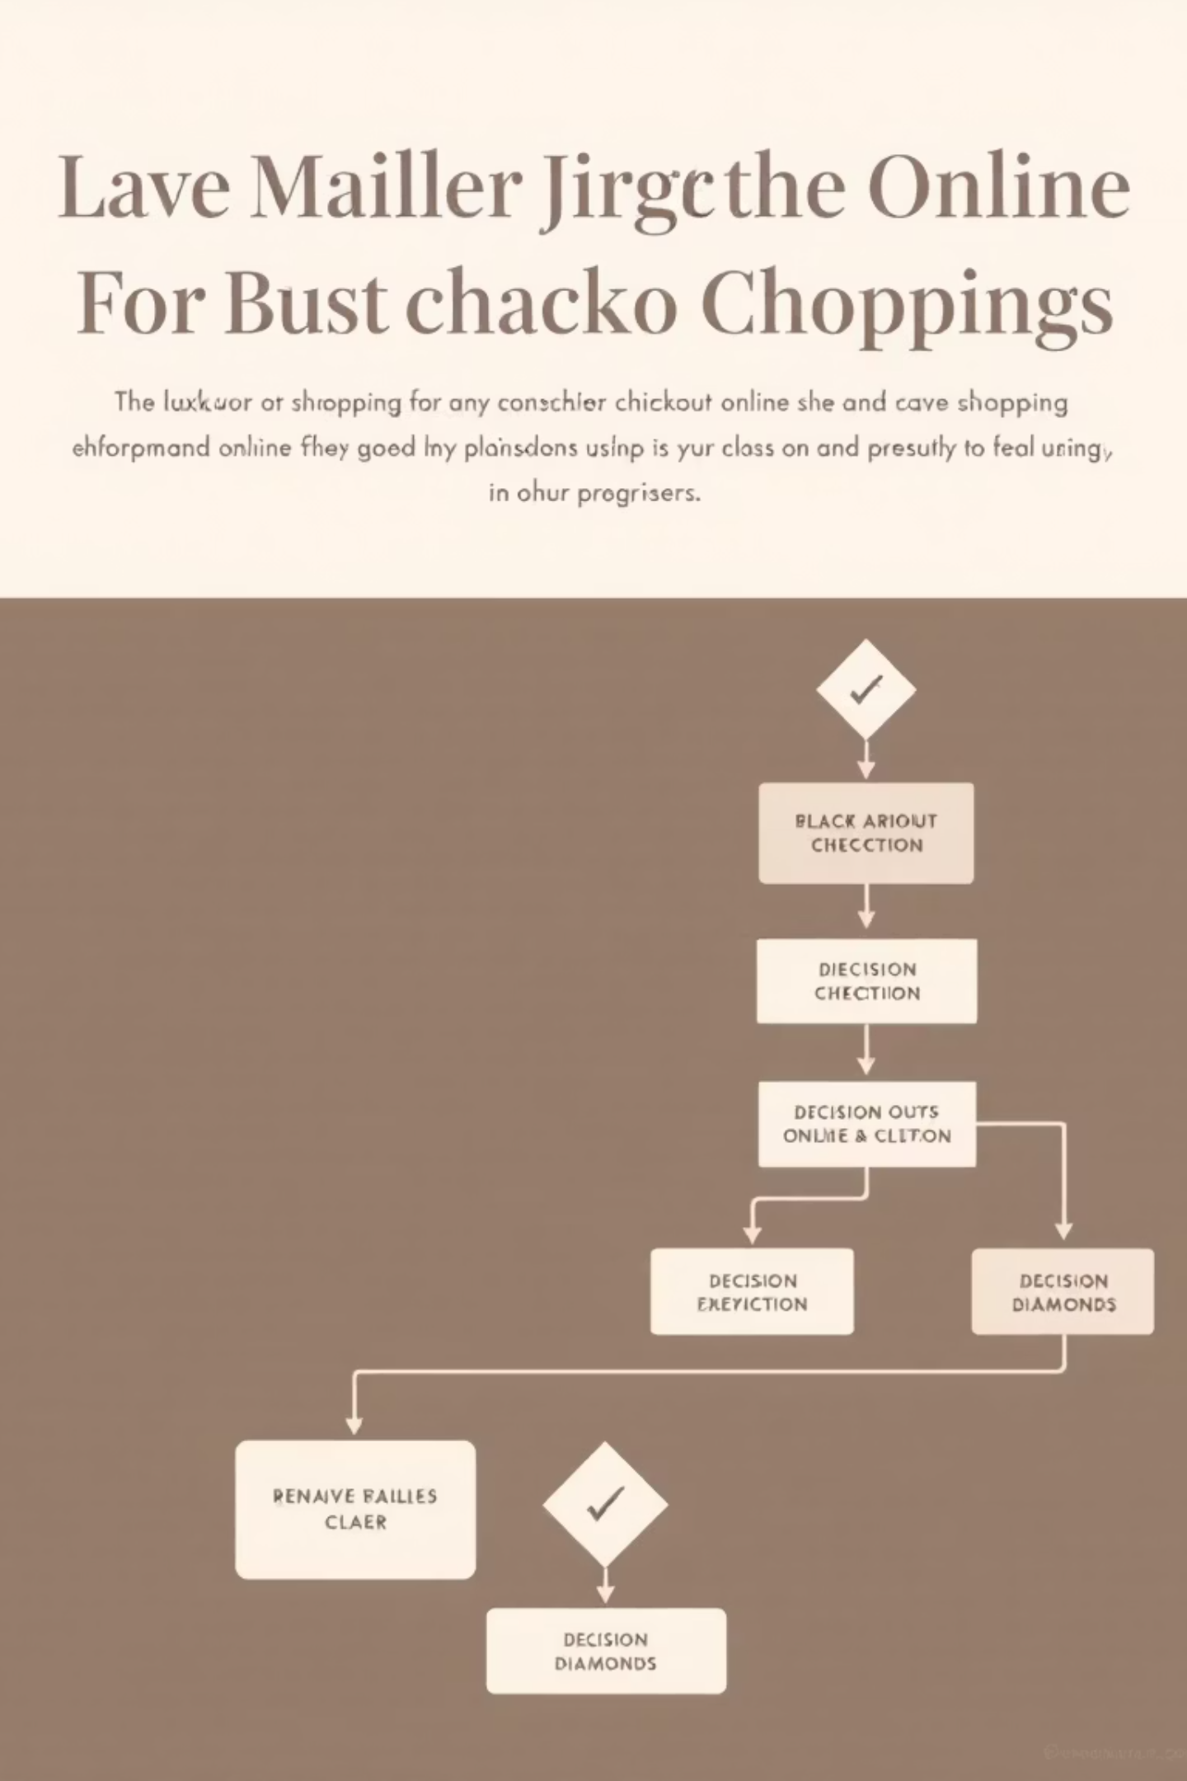
Visual Logic
Checkout Process Flowchart
A visual representation detailing every step involved in the checkout process, from cart review to order confirmation.

Slide 10
📝 Pseudocode: Checkout Logic
BEGIN DISPLAY "Welcome to Online Shopping Checkout" DISPLAY cart_items INPUT delivery_address INPUT payment_option DISPLAY "Would you like to finalize the order?" INPUT order_confirmation IF order_confirmation IS "yes" THEN DISPLAY "Proceeding with the payment..." SET payment_successful TO TRUE IF payment_successful IS TRUE THEN DISPLAY "Order confirmed! Thank you for shopping." ELSE DISPLAY "Payment failed. Please try again." ENDIF ELSE DISPLAY "Order cancelled." ENDIFEND
This pseudocode explains the logic step in layman terms, showing the decision-making process during checkout.

Slide 11
🐍 Python Implementation: Checkout Simulation
print("Welcome to Online Shopping Checkout")cart_items = ["item1", "item2", "item3"]print(cart_items)delivery_address = input("Enter delivery address: ")payment_method = input("Enter payment method: ")user_confirmation = input("Do you want to confirm the order? (yes/no): ")if user_confirmation.lower() == "yes": print("Processing payment...") payment_successful = True if payment_successful: print("Order confirmed! Thank you for shopping.") else: print("Payment failed. Please try again.")else: print("Order cancelled.")
This Python program demonstrates the checkout process logic in a simple, interactive way that users can run to simulate the experience.

Slide 12

Appreciation
Thank You!
Thank you for joining us on this exploration into the computational thinking behind online shopping checkout.
Your engagement and valuable time are greatly appreciated.

